Slide 1
User guide and presentation for the doorboard11 prototype
All professors’ information in this prototype are from http://www.cs.umd.edu/people/faculty
All icons were from http://fontawesome.io/

Slide 2
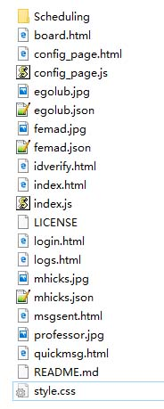
Getting started
Main interface for physical doorboard
After downloading the package, you will be able to see these files.
Main interface for client, which owner of the door board can use to configure his board and receive notification and messages.

Slide 3
Faculty view and usage of the door board.

Slide 4
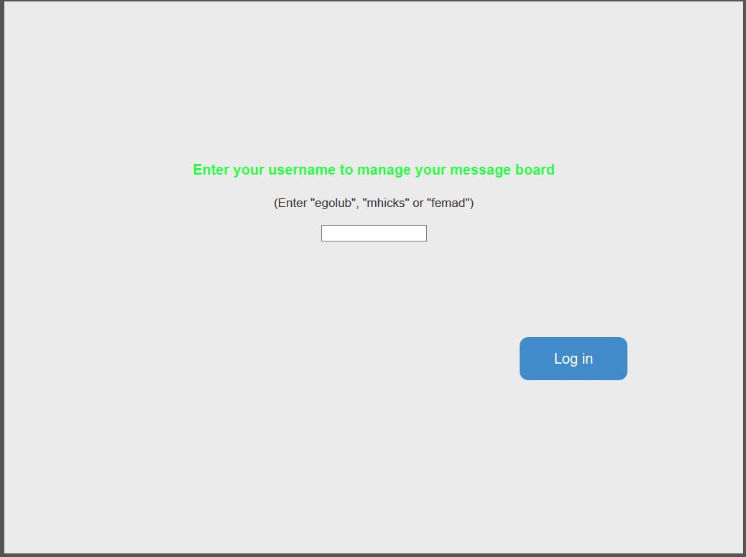
Opening login.html allows the faculty member to access the login screen that leads to the configuration/admin view of their board.

Slide 5
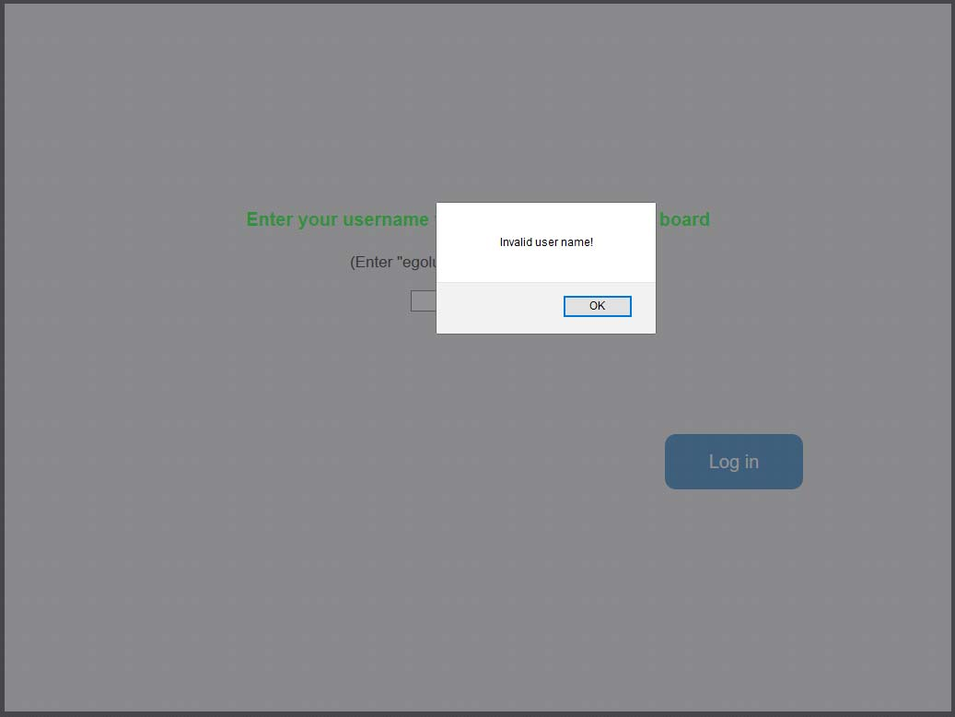
If any empty name is entered, an “invalid user name” alert will be shown.

Slide 6
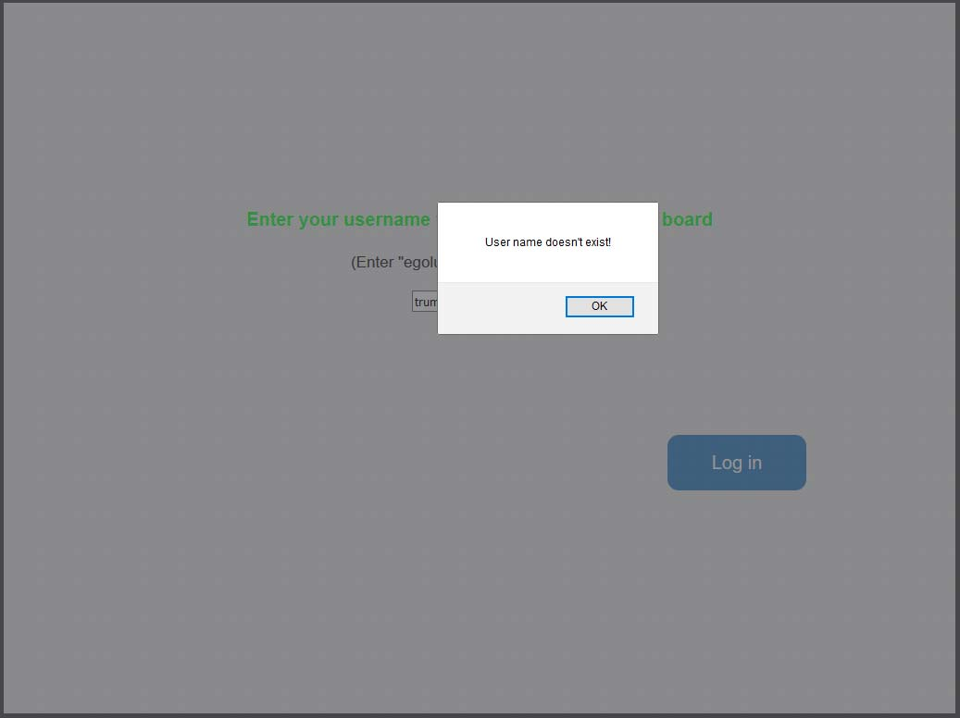
If an username that is not in the database is entered, a “doesn’t exist” alert will be shown. At current stage, there are 3 users in the database: “egolub”, “mhicks” and “femad”.

Slide 7
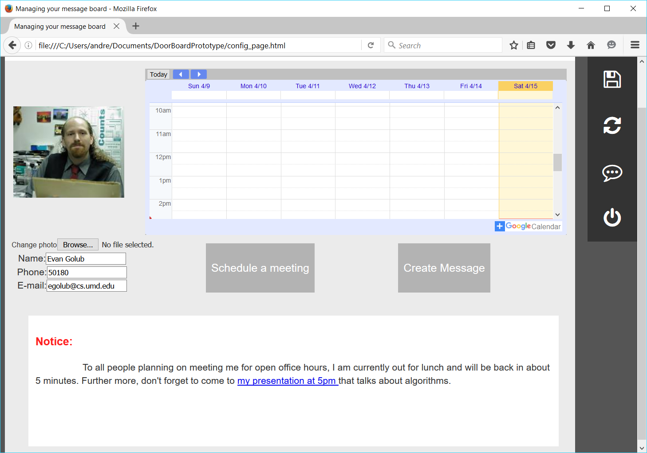
Login as “egolub”, you will be able to see the configuration page where you can change your information and check notification/messages from your doorboard.

Slide 8
A tool bar with four buttons will show up on the top right corner.

Slide 9
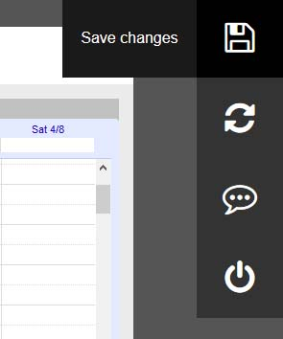
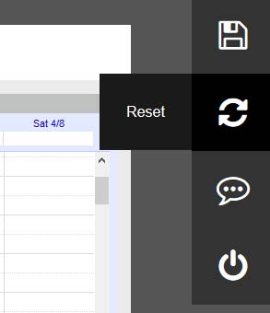
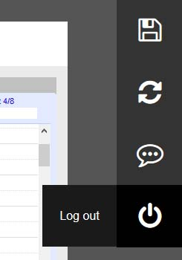
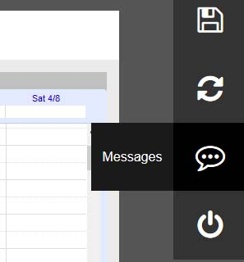
You can mouse over them to see the tool tip.

Slide 10
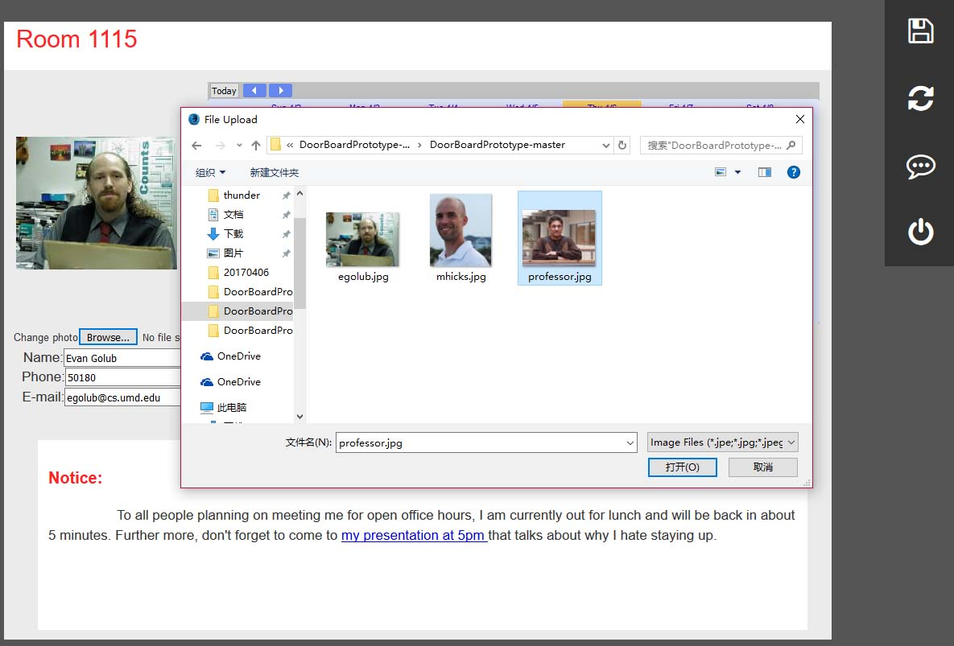
By clicking on the browse button, you can change the profile photo.(The photo has to be at the same directory as these html files)

Slide 11
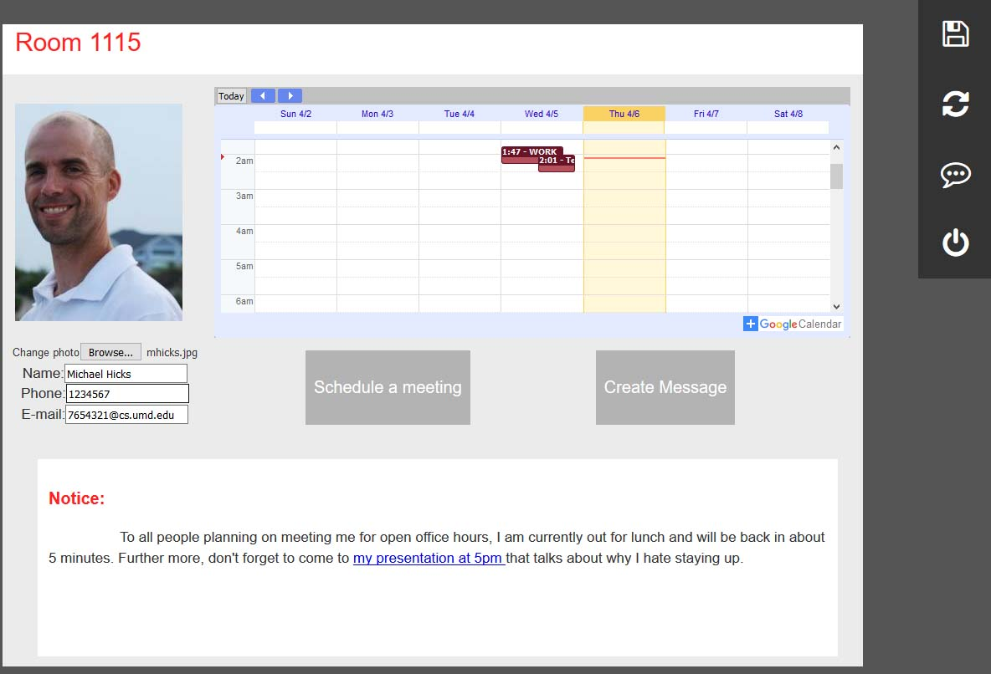
After selecting the photo, you can see the preview.
You can also change any information in these text box.

Slide 12
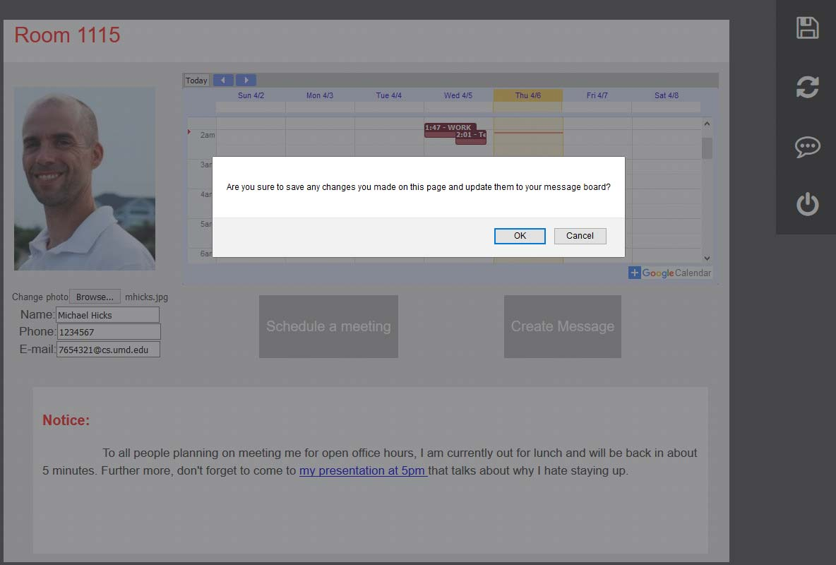
All changes will not be saved until you click the save button.

Slide 13
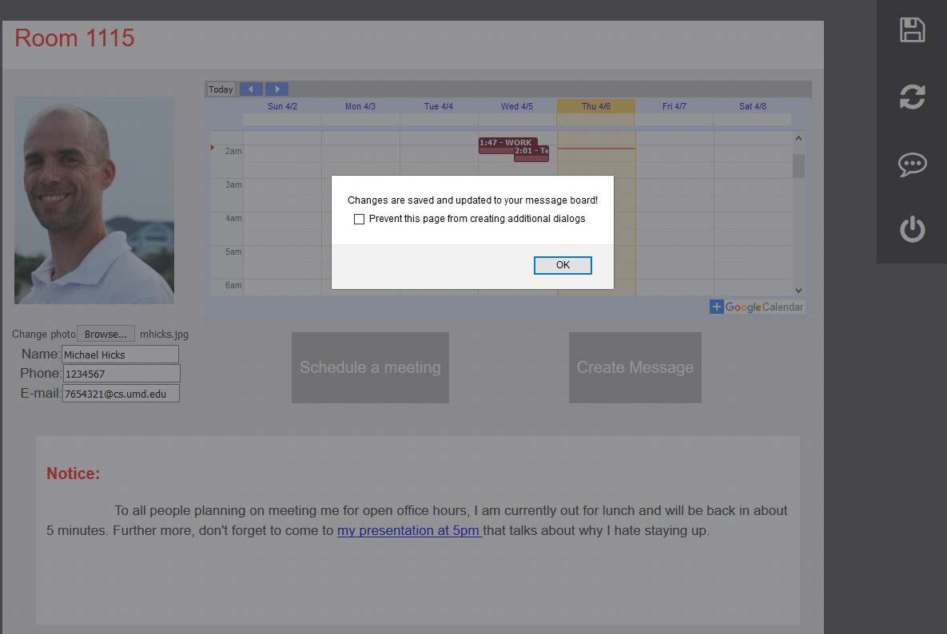
After confirmation, all changes will be saved and shown on doorboard.

Slide 14
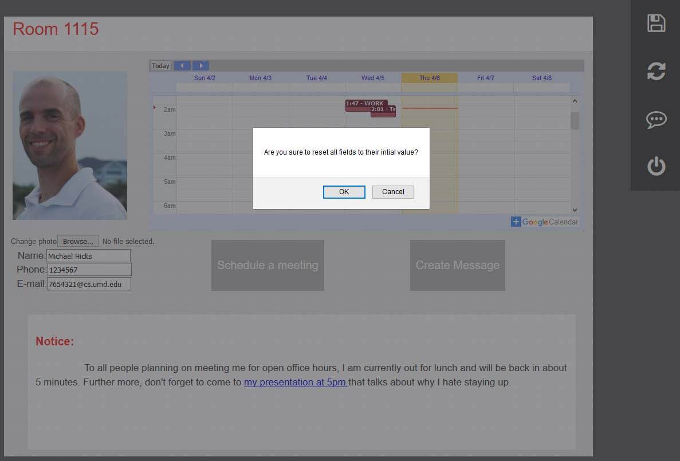
You can use the reset button if you want to reverse any changes you saved.

Slide 15
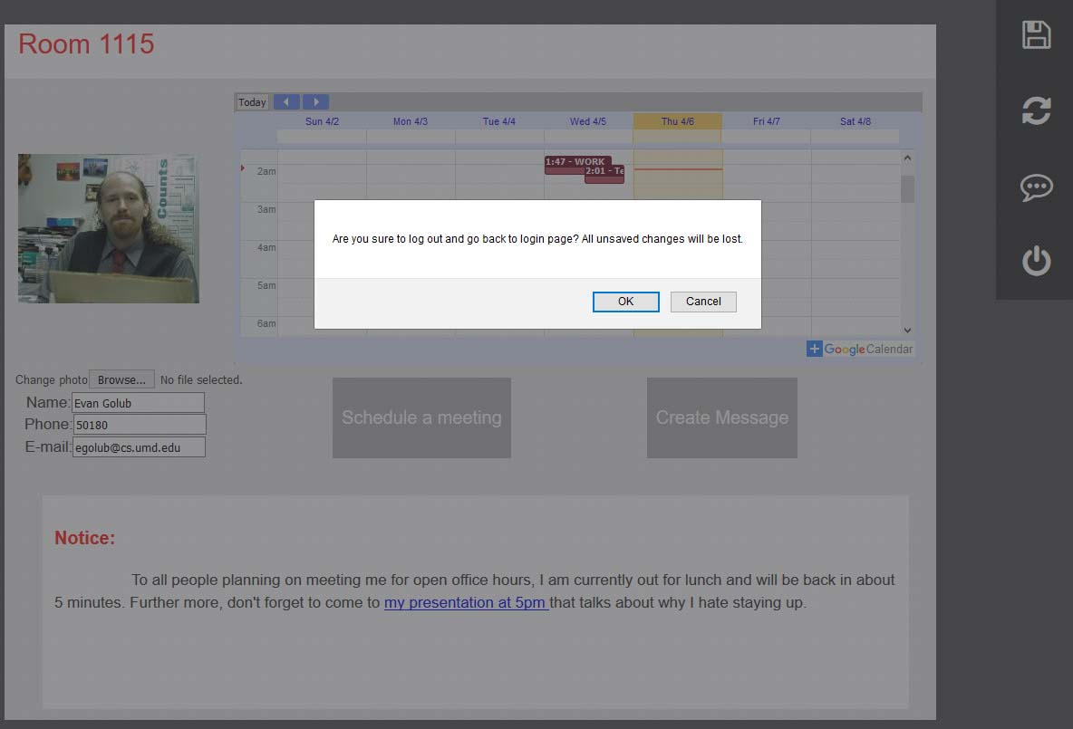
By clicking the log out button, you can go back to the login page.

Slide 16
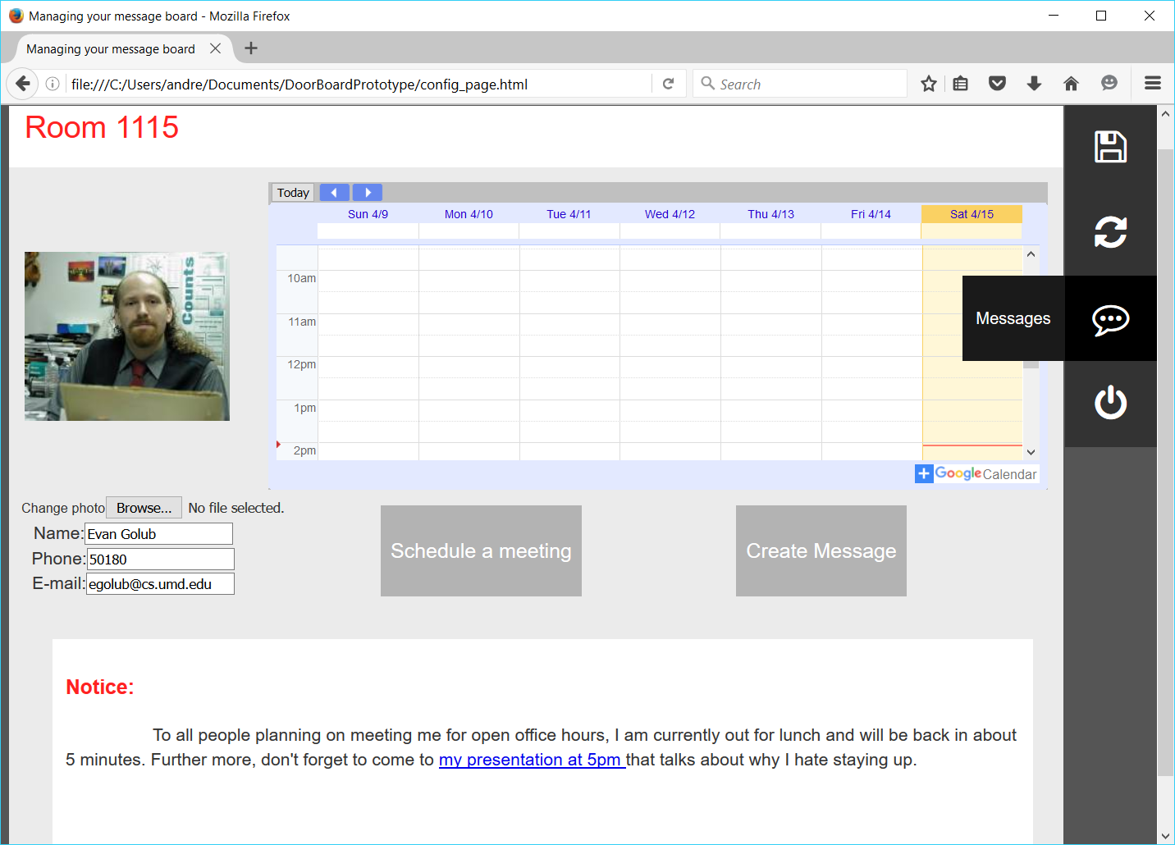
In order to access notifications left by students or guest that have accessed your door board, you have to log in to your configuration board. From there, you can click view logs.

Slide 17
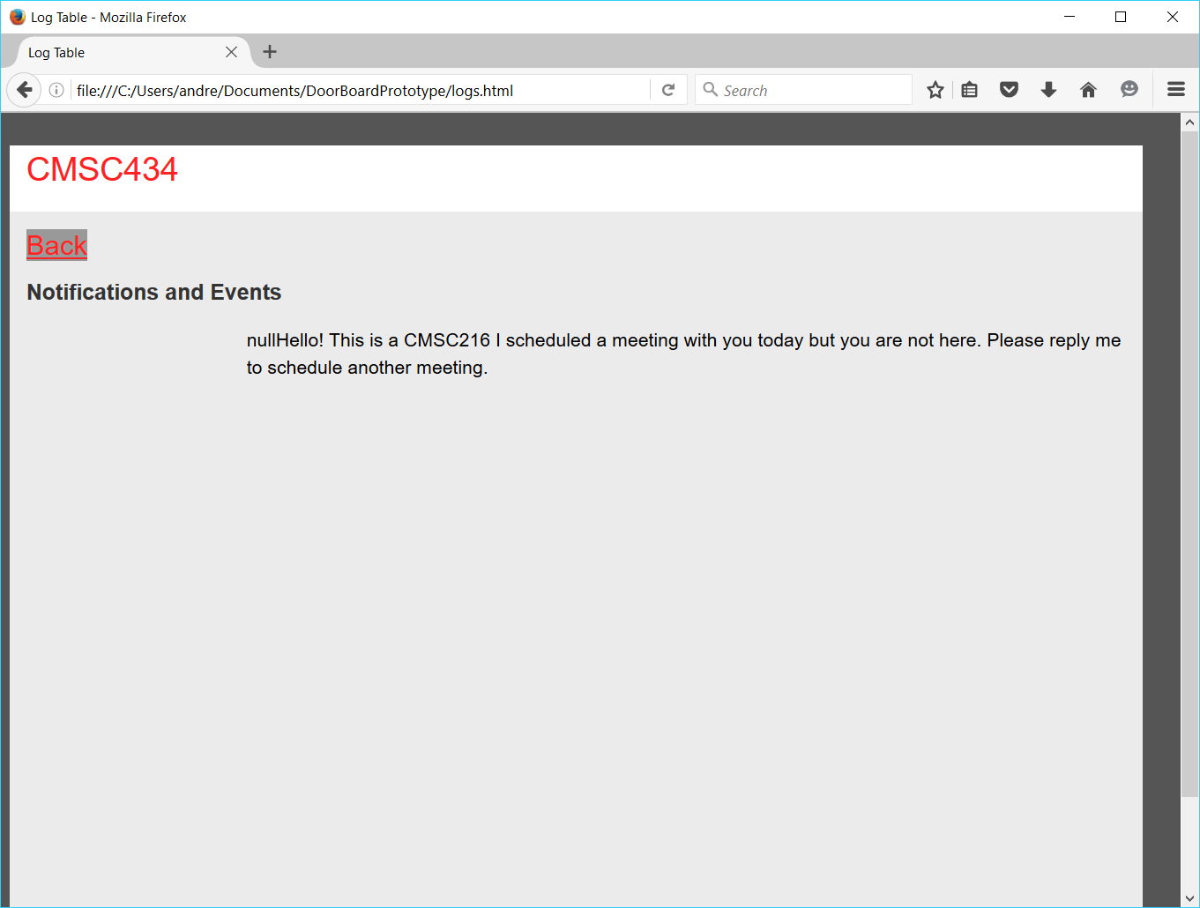
Messages and events scheduled on the doorboard by students show up here. Clicking the back button allows the faculty member to return back to their previous page.

Slide 18
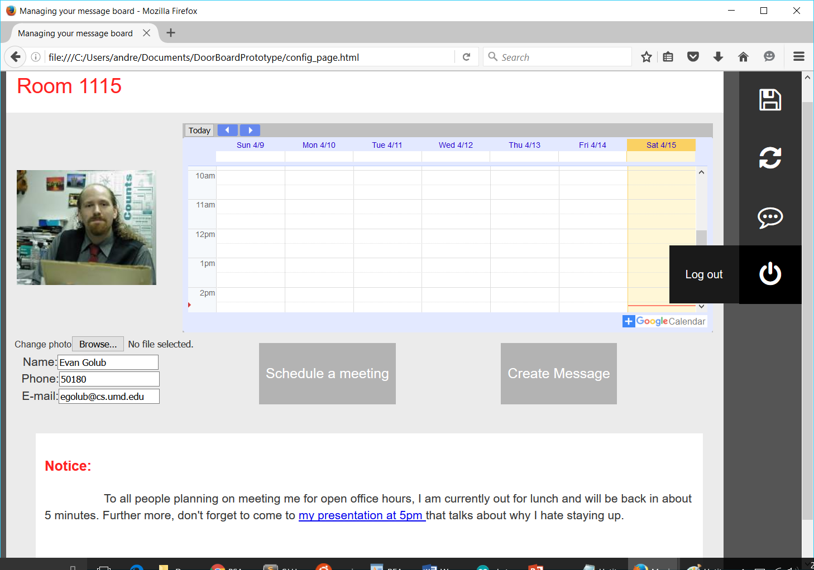
The “log out” button allows the faculty member to log out of their account.

Slide 19
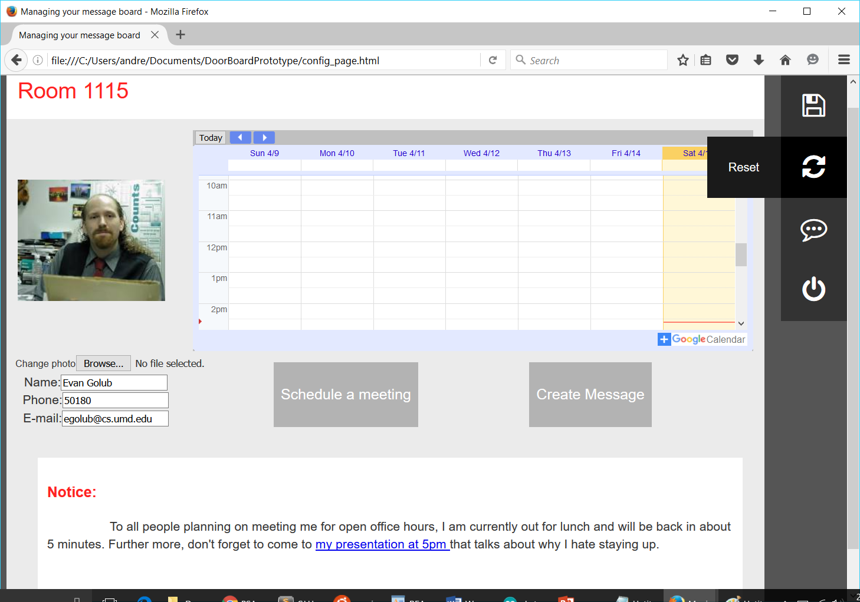
The “Reset” button allows the faculty member to reset any changes they made to their door board back to their initial values.

Slide 20
Visitor view and usage of the door board.

Slide 21
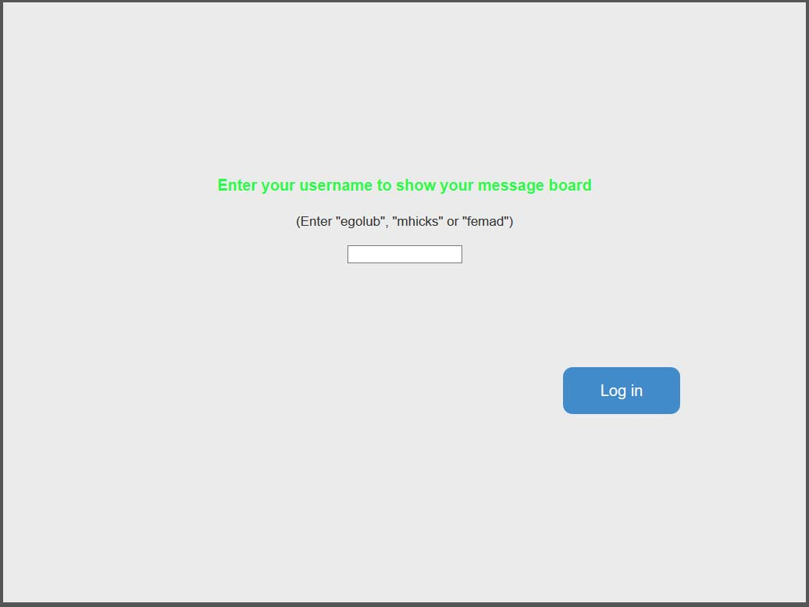
Going to board html allows the faculty member to physically set up the door board. Opening up with one of these three usernames will show corresponding display on the door board. This door board is what the visitor will see.

Slide 22
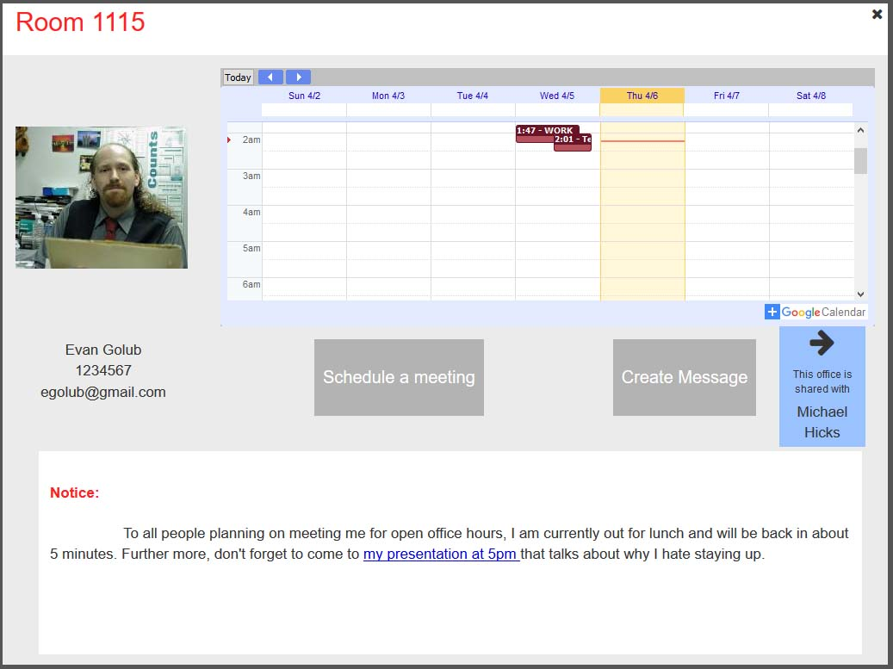
This is what the page looks like on the door board.
If two faculties share the same office, a switch button will appears on the right. Clicking it will switch the board to show other faculty’s page.

Slide 23
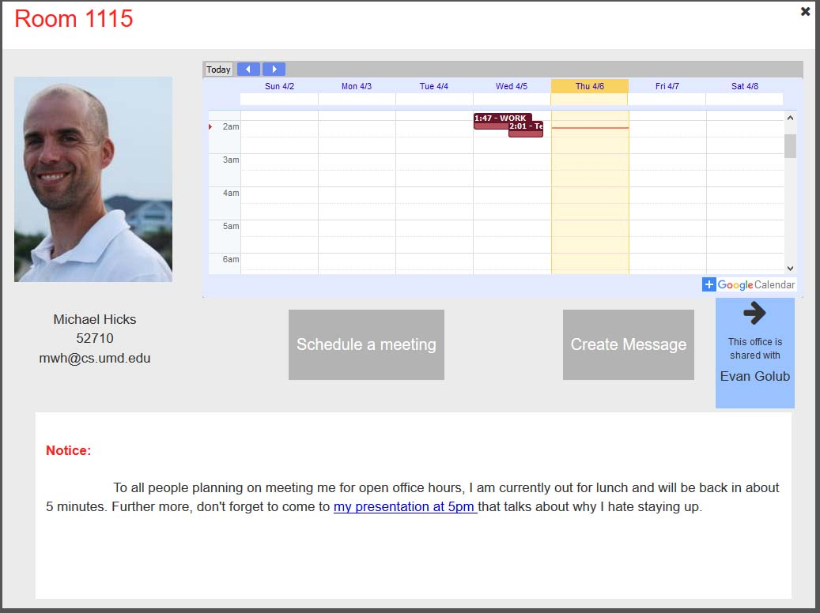
You will go back to the login page if you click on the x button. WHY IS THIS A FEATURE???

Slide 24
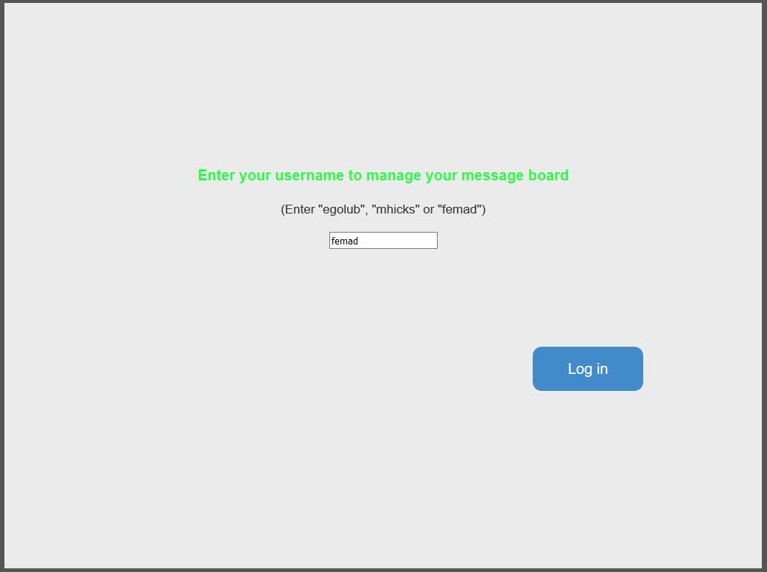
By using another username, you can see what other pages look like on other doorboard.

Slide 25
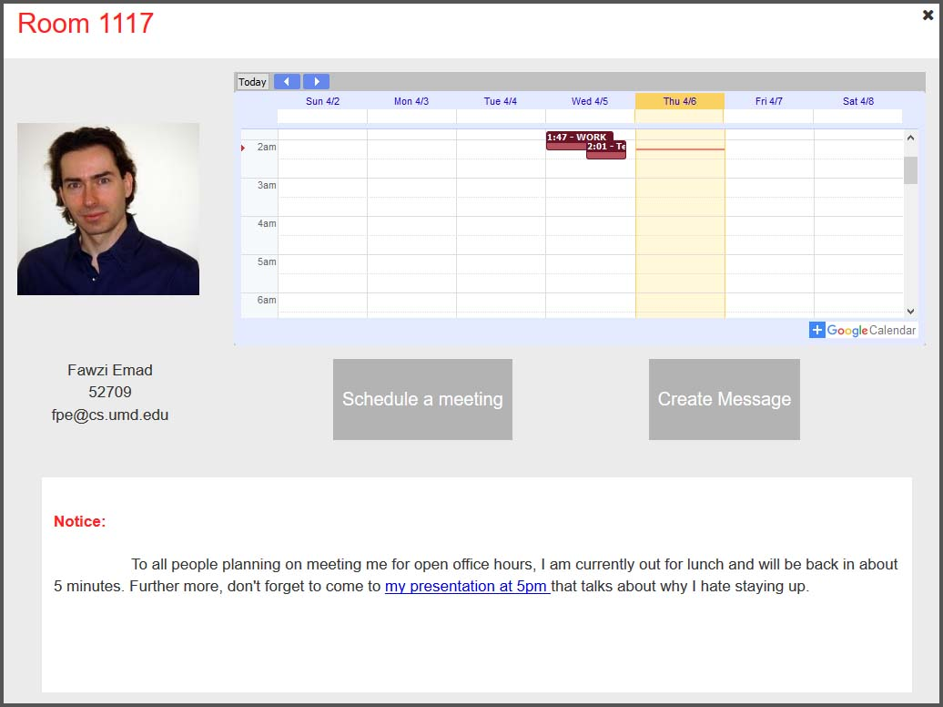
If there’s only one person owns the office, such button will not be shown.

Slide 26
The “create message” button enables visitors to send a quick message to the owner of the doorboard.

Slide 27
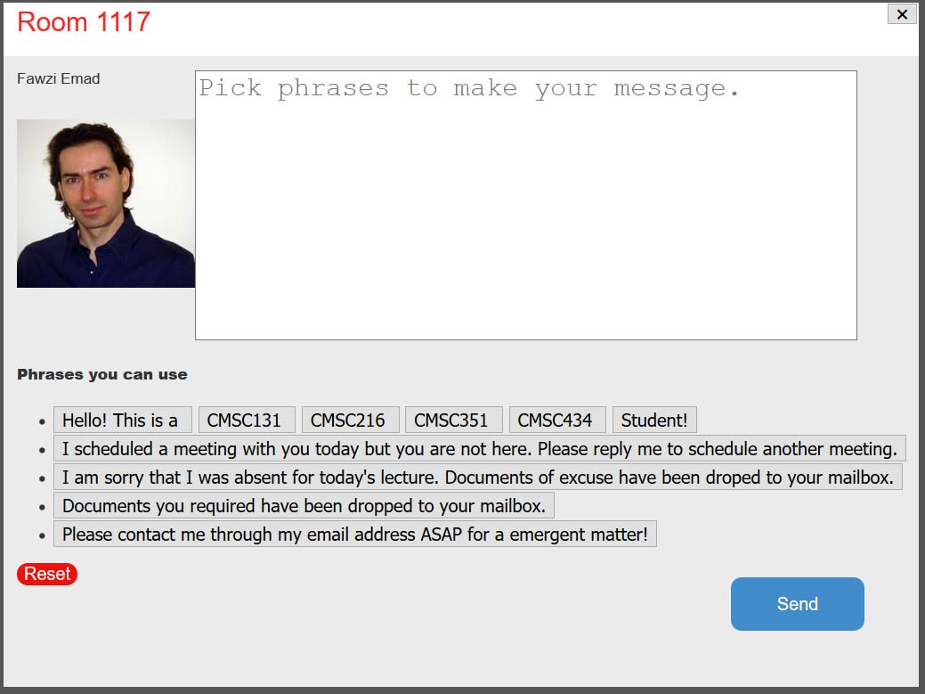
Click on button, the interface where you can create the message by either picking phases or typing directly on the text area will show up.

Slide 28
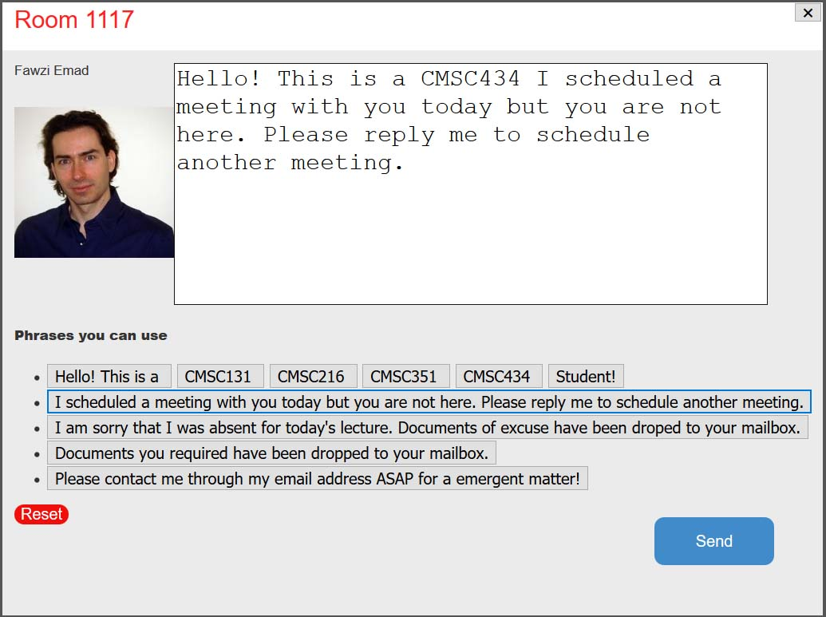
You can go back by click the cross on top right of the screen.
If you finish the message, you can send it by clicking the send button.
Click on the reset button will clear everything in the text area above.

Slide 29
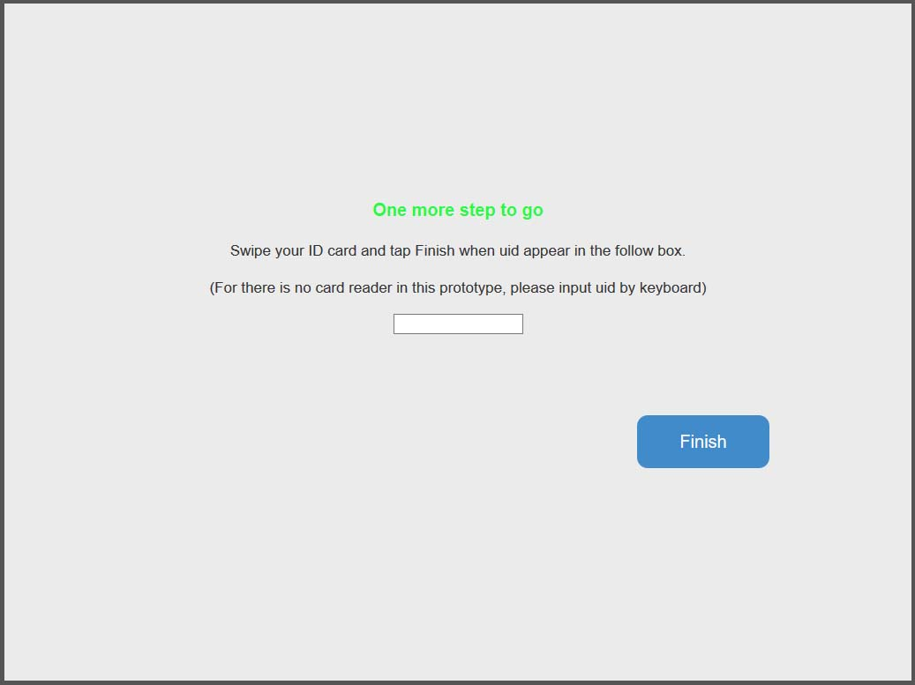
If you click the send button, you will need to swipe your id to finish the process.

Slide 30
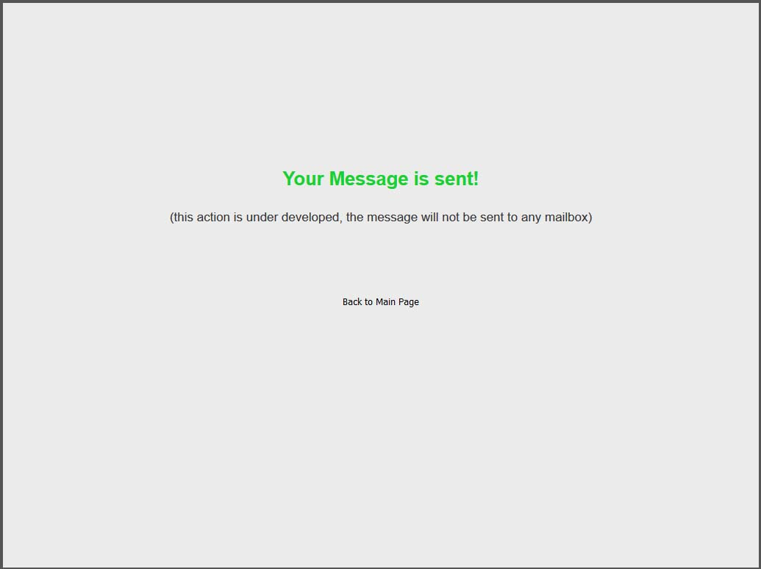
Confirming a returns a message stating that you successfully completed an action that requires authentication, and you can now click the back message to return to the main page.

Slide 31
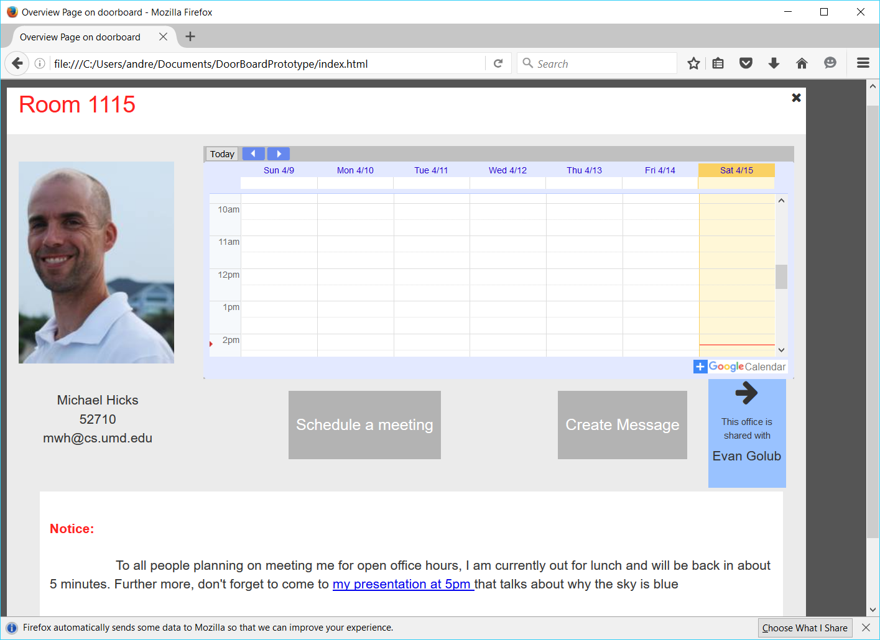
The “Schedule a meeting” button enables visitors to schedule a meeting with the owner of the door board. Scheduling an event is similar to creating a message, where the user has to validate their credentials before the request is complete.

Slide 32
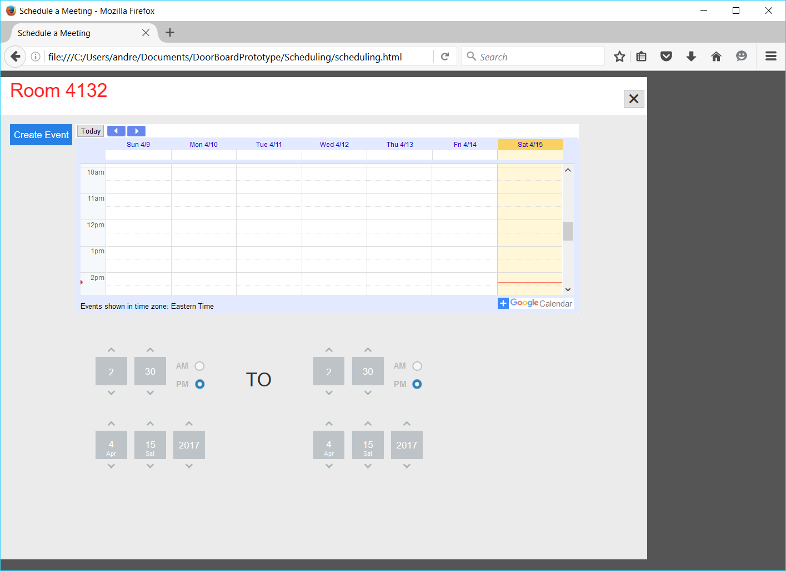
Clicking the button allows visitors to schedule a meeting with the faculty member. There are 2 sections where a visitor can change the time below the calendar. Once a time is selected, the visitor can click “Create Event” to confirm the event. The user can also click on the x on the top right to cancel their event.

Slide 33
Questions?

